Slide 1
Economics Introduction
Economics is the study of how we make the best use of resources in order to satisfy the needs of as many people as possible

Slide 2
The study of Economics is split into:

Slide 3
Resources

Slide 5
Think About this
I can only buy either a new top or a new skirt from TopShop but I can’t afford both. (Opportunity Cost)
As the Minister for Finance, I will spend more money on education than I will on hospitals- I can’t spend the same amount of money on both.
These statements are choices that can affect all members of society. This happens because we do not have enough money to do everything that we want to do. Therefore, we must decide on our priorities and what is most important to us at any given time- we cannot satisfy all needs and wants as we do not have unlimited resources

Slide 7
Wants v Needs
What does this picture say to you about needs and wants?

Slide 8
Ideal Economic Business Cycle
Unfortunately this is not always the case. Why?

Slide 9
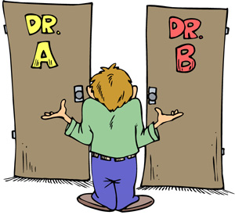
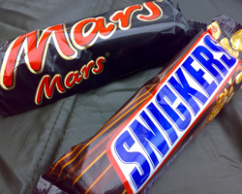
Opportunity Costs
Because resources are scarce and because we must make choices in relation to our resources and needs, there is always an opportunity cost involved in all transactions.
Opportunity cost is the item (s) we chose to do without when we have to make a choice between products and services.

Slide 10
So the Question is…
What is to be produced with limited resources?
How will we produce goods and services and what will be used to produce them?
Who gets what in the economy?
Economics studies these decisions, how they are made, and what their consequences are both at a micro level and a macro level

