Slide 1
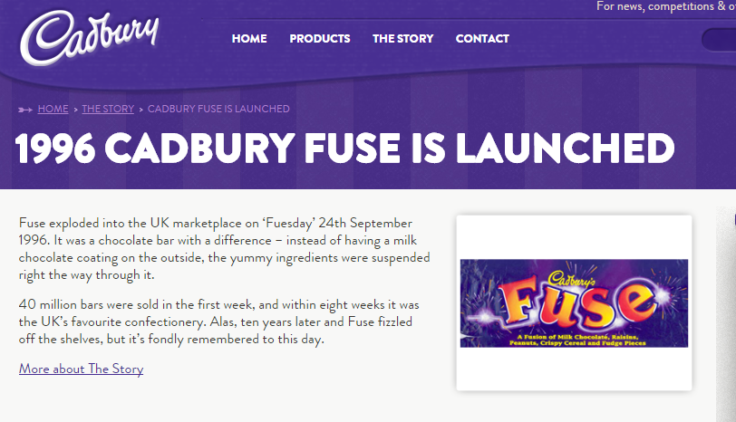

Slide 2
Development Process of a New Product
Idea Generation
The business examines sources and comes up with good ideas by brainstorming.
Cadbury’s Fuse bar was found after their market research found the growth of snacking and the R&D team was asked to combine various ingredients.
Product/Service Screening
The best ideas are chosen after a SWOT analysis.
This is looking at its Strengths/ Opportunities/Weaknesses/ Threats
Cadbury rejected recipes until it narrowed down the ideas.

Slide 3
Development Process of a New Product
Concept Development
Writing an essay bout what the product will do, what it will look like, what is its USP.
Cadbury decided that they would fuse together different ingredients.
Feasibility Study
Find out if it is possible to make the product and if it will make a profit.
This is done through cash--‐flow forecast and breakeven chart.
Cadbury did both these tests and found out that it would be profitable.

Slide 4
Development Process of a New Product
Prototype Development
Make the first working model of the product and eliminate any bugs.
Cadburys tried out various combinations and packaging until it finalised it.
Test Marketing
Launching the product on a small scale of the market and evaluating the response.
Cadbury did this and it received highest rating ever for new Cadbury’s product.

Slide 5
Development Process of a New Product
Product Launch
Company must undertake marketing campaign with launch of product.
Cadbury held one on one briefings with big retailers, advertised in the media and PR stories were given to the press

Slide 6
Discontinued in 2006
Unfortunately the Fuse Bar was discontinued in 2006, but there have been many campaigns to try and bring the chocolate bar back. It is however a great example in the stages of product development that you will need to be familiar with this year.

Slide 7
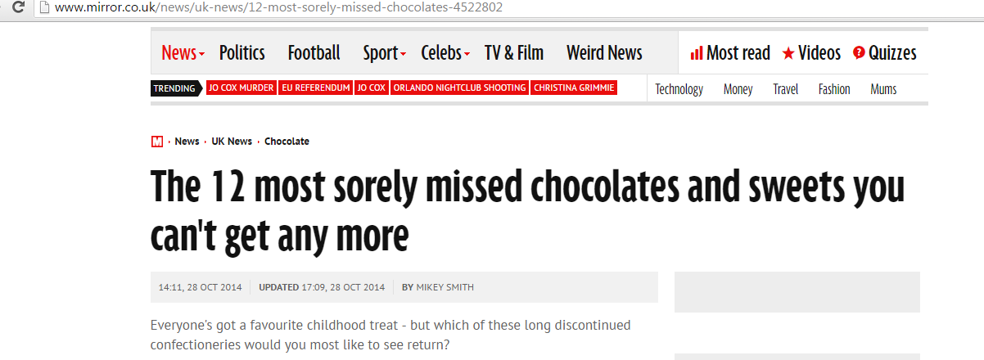
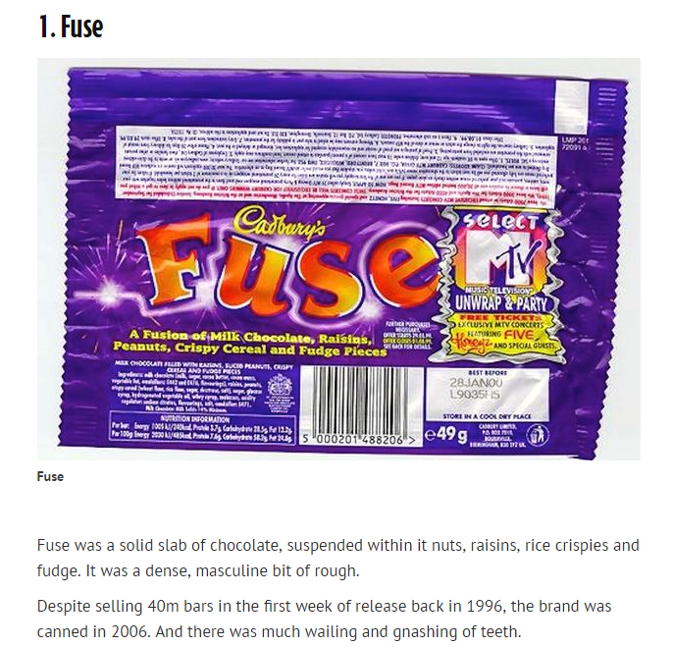
Campaigns to bring it back

Slide 8
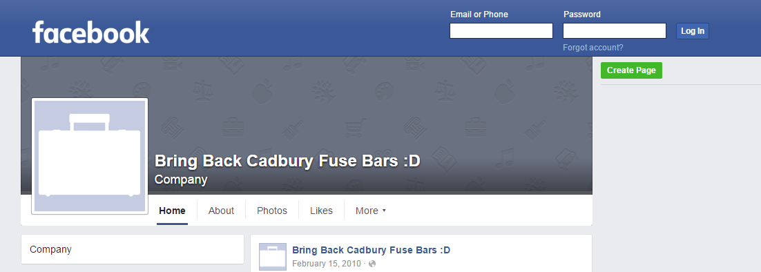

Slide 9
Class discussion
Give possible reasons as to why this bar was discontinued.

Slide 10
Task
For today’s class, you are tasked with researching the stages of development for a product or service of your choice, and presenting this information on your I-Pad. Please include pictures, YouTube videos etc… if possible.

