Slide 1
Questions to Consider
What is the difference between Insurance and assurance? Please use an example in your answer.
Explain the 5 principles of insurance?
What are meant by the following key terms:
No claims bonus, actuary, insurance broker, insurance agent, excess clause, proposal form, average clause.
Work on calculations for average clause, house, motor, life insurance/assurance

Slide 2
Insurance and Assurance
Insurance is the protection against something that might happen, e.g. a car insurance for car crash or house insurance for your house going on fire
Assurance is protection against something that will happen, e.g. life assurance because you will die

Slide 3
Insurance and Assurance
With insurance/ assurance, the worry of the risk is shared in a fund run by the insurance company
The people who suffer a loss claim compensation. This can be in the form of money or replacement item, e.g. €2000 for car crash injury or replacement phone if you have lost yours

Slide 4
Types of Personal Insurance
House Insurance- Covers a building and its contents
Mortgage Protection Insurance- Compulsory before buying a house. If the person dies before the mortgage is paid, the insurance company will pay the remainder

Slide 5
Motor Insurance
This insurance covers a driver in case of an accident. There are 3 types:
Third Party: This covers the other driver (3rd Party). Minimum required by law
Third Party Fire and Theft: This covers the other driver (3rd Party) and any fire or damage to your car
Fully Comprehensive: Everyone involved

Slide 6
Principles of Insurance
Sometimes, people can make fraudulent claims for insurance. To prevent this from happening, the insurance industry has rules, known as the 5 Principles of Insurance
These principles are: 1. Utmost Good Faith
2. Insurable Interest
3. Indemnity
4. Contribution
5. Subrogation

Slide 7
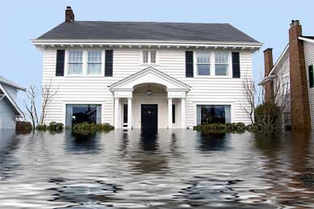
Utmost Good Faith
You must tell the truth when applying for insurance
Example: if you apply for house insurance but fail to tell the insurance company that your house is located beside a river that has a history of flooding.
If you fail to tell the truth when the claim is made, no compensation will be paid

Slide 8
Insurable Interest
You are responsible for it
I have an insurable interest on my I-Phone as I benefit from its existence and suffer from its loss. I do not have an insurable interest on anybody else’s phone as it is not my property
However, if I borrowed it and lost it, I would have an insurable interest because I would have to replace it

Slide 9
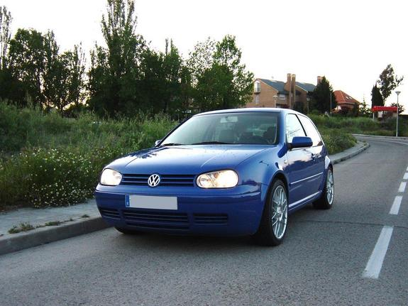
Indemnity
The insured person cannot make a profit from insurance
You only get compensation for the value of the loss or damage suffered by the insured person
Example: If I insure my car and it crashes, I am not entitled to a Ferrari as a replacement

Slide 10
Contribution
The insurance company will share the indemnity between them if somebody fully insures an item between more than one insurance company
Example: I insure my car for its value (€2,000) with Quinn for €2000 and Aviva for €1000. I have a crash causing €1500 damage
Remember: I cannot make a profit on insurance, In the event of a claim, Quinn will pay me 2/3 and Aviva will pay me 1/3.

Slide 11
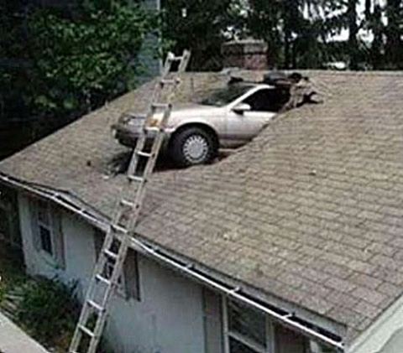
Subrogation
Once the insurance company fully pays out to the insured person, then all savage rights pass to the insurance company
Example: If your car is written off as a result of a crash, your insurance company fully indemnifies you (put you back in original position before loss occurred). The insurance company now has the right to sell off scraps from the car as otherwise you would have made a profit

Slide 12
Applying For Insurance
Actuary: Person who calculates insurance premiums based on risk involved
Insurance Policy: The actual contract of insurance which contains all necessary details such as age, medical history etc

Slide 13
Key Terms Affecting Insurance Form
Premium: This is the price paid for insurance
Loading: Increase in a premium due to an extra risk, e.g. Smoking for health insurance
No Claims Bonus: Reduction in a premium if the insured person has not made a claim on the policy
Assessor: Employed by insurance company to make sure claims made are covered in the policy and investigate the damage

Slide 14
Average Clause
Limits the value of the claim if you are under insured.
Formula= Sum Insured/True Value x Loss
Example: House worth= €200,000
Insured For= €100,000
Damage= €25,000
100,000 (Sum Insured) /200000 (True Value) = 0.5
25000 x 0.5 = €12500

Slide 15
Practice Questions
House worth: €500,000
Insured for €250,000
Damage: €150,000
Car worth: €15,000
Insured for: €10,000
Damage: €1,000

Slide 16
Practice Solution
Sum Insured/True Value x Loss
€250,000 (sum insured)
€500,000 (true value) x €150,000 (loss)
= 1
2 x €150,000 = €75,000

Slide 17
Key Terms in Insurance
Insurance Broker: Self-employed individual selling insurance on behalf of many different insurance companies
Insurance Agent: Employed by one insurance company and sells on behalf of them
Exclusion clause: Points out occasions insurance companies will not pay out, e.g. Acts of God
Excess Clause: States the value of the risk being incurred

