Slide 1
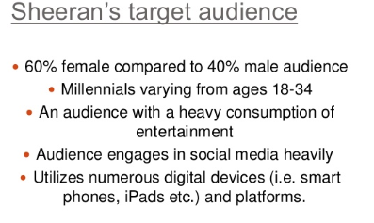
Target Market
A Target Market refers to all people who might buy a particular good or service. They all share a common need. The Target Market will have something in common and are targeted by the advertisers
Example Target Market for Ed Sheeran tickets would be Pop Music Fans

Slide 2
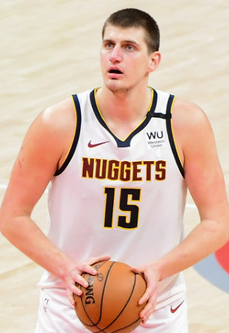
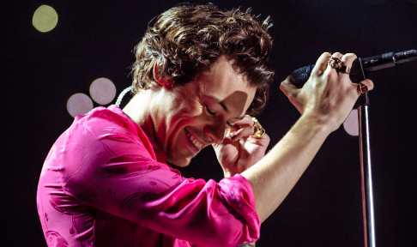
Target Market
Who would be the Target Markets for the following products?

Slide 3
Target market
So we know that a Target Market is a group of potential customers who share common needs and wants that a business will focus ALL of its efforts on.
Q. Why doesn’t a business focus on all possible customers instead of a targeted group?

Slide 4
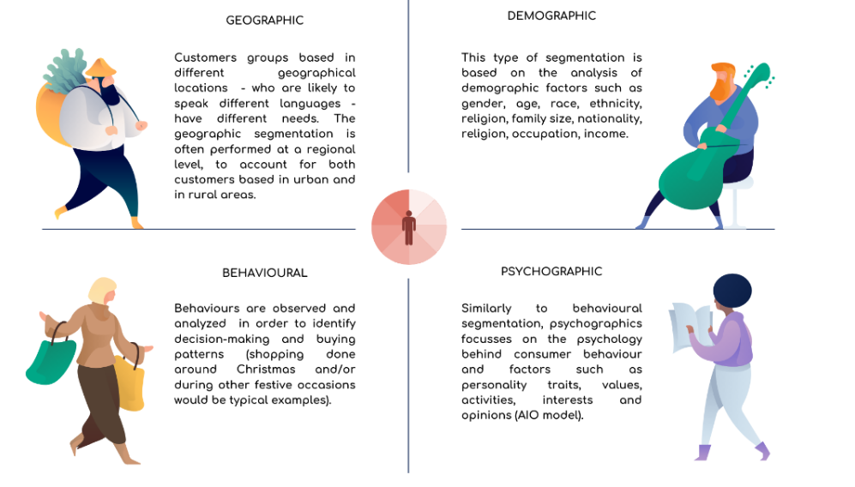
Segmenting your Target Market

Slide 5
Demographic - Quantitative data that defines population as statistics
Age
Gender
Education
Occupation
Income
Ethnic background
Marital status

Slide 6
Demographic - Quantitative data that defines population as statistics

Slide 7
Geographic – Segmentation based on where consumers are located
Country
Region
State
City
Physical Climate
Zip Code (US) Eircode (Irl)

Slide 8
Geographic – Segmentation based on where consumers are located

Slide 9
Geographic Activity
Search the product/services offered by McDonalds in the following countries:
Ireland
USA
India
Korea
France

Slide 10
Geographic
McDonalds Geographic Segmentation
https://youtu.be/8U2ZziVR8Y4

Slide 11
Psychographic
Characteristics relate to psychological influences, including subconscious or conscious beliefs, motivations, and priorities.
Lifestyle choices
Personality
Activities
Interests
Opinions
Values
Habits
Beliefs

Slide 12
Psychographic
Coca- Cola Psychographic Segmentation
https://youtu.be/bqjE6TLetFs

Slide 13
Behavioural
Behavioural segmentation categorizes your visitors into groups based on a shared, specific behaviour pattern like:
Their purchasing behaviour. For example, do they buy at the same time of year?
The customer journey. Whether they’re considering making a purchase or they’ve just bought.
The awareness stage. For example, they may be product-aware and compare your product with other options.
Their knowledge. What do they know about your brand and products?
Product usage. How do they use your product?

Slide 14
Behavioural
Nike Behavioural Segmentation
https://youtu.be/q2o4RtbBL9A

Slide 15
Task
Research a product/service for each of the 4 market segments and explain how the business uses each of the segmentation strategies as part of targeting their customers.

